Slide 1
Advanced Software Engineering processes - Assignments
House of Quality
Testing
Code Review
Code Refactoring

Slide 2
House Of Quality - HOQ
Brief overview of what house of quality is.
A diagram resembling a house used to correlate customer desires to product capabilities.
HOQ is part of Quality function deployment, a planning matrix to relate what the customer wants to how the firm that produces products will handle these wants.

Slide 3
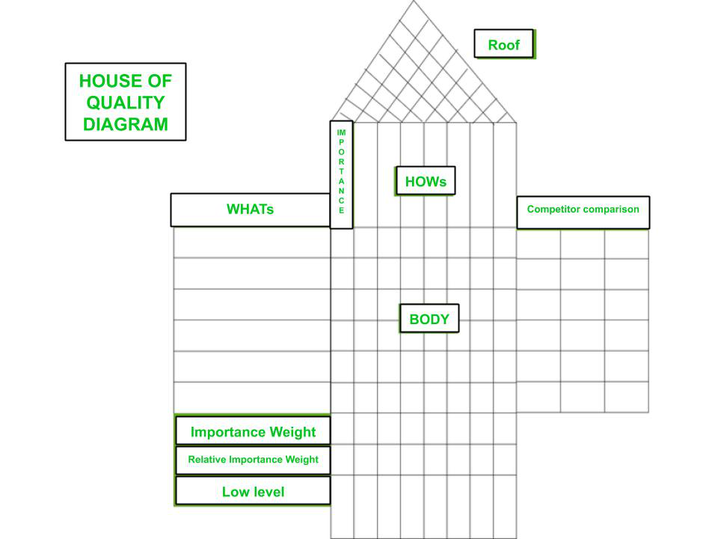

Slide 4
Beefed Rolex HOQ

Slide 5
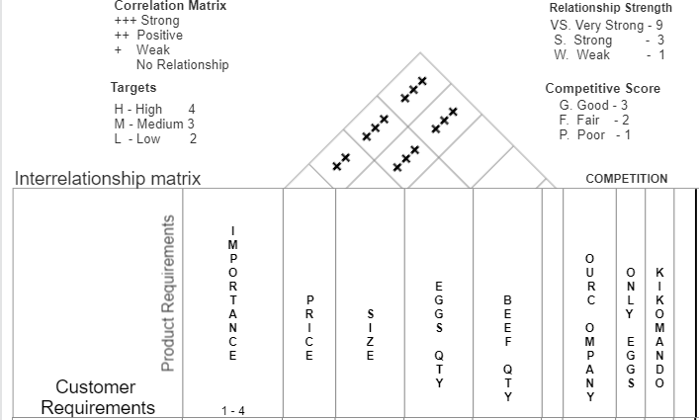

Slide 6
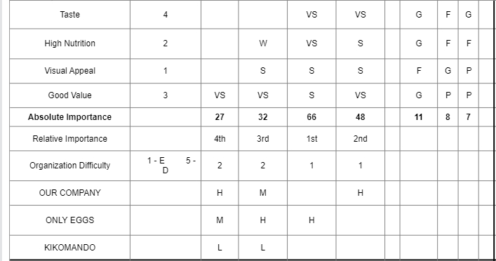
Price
Size
Eggs
Beef
5 -
TARGETS
H

Slide 7
Steps involved in Constructing a Beefed Rolex HOQ
Recording voice of the customer(their wants or needs)
Ranking the importance
Translate customer wants into the technical descriptors
Examine relationships between design between design and the customer requirements.
Ranking what is important in terms of Design
Look at relationships in design requirement themselves
Customer rating of competitors(their perception of us to our product)
Organizational difficulties on delivering required product.
Recording targets with technical evaluation of the competitors.

Slide 8
What I have learnt out of HOQ
Customers play a vital role in requirements engineering
The HOQ designing can be time consuming but it is so helpful
HOQ helps in prioritizing requirements.
Guides in mapping customer wants to technical capabilities
Helps to understand the competitors and how to edge them.

Slide 9
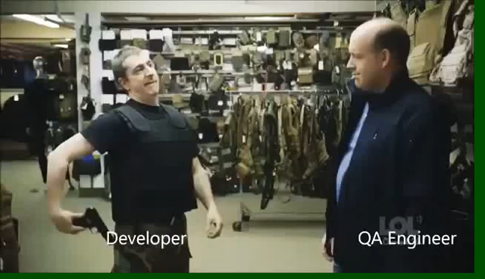

Slide 10
TESTING
Aim: To select an application and perform testing techniques over it using selenium as a testing tool.
Application Selected: E-Commerce Platform
Software type: Web Application.
Features of Testing-Shop include Newsletter, Email, Inventory, Payment Gateways, and Shipping etc.
Built on: Django (Python web based framework)

Slide 11
Software Testing Tools selected:
Functional Testing Tool: Selenium
Types of testing we intend to do:
Functional Tests:
Unit Testing
Black Box Testing
Non-Functional Tests:
Load Testing
Stress Testing

Slide 12
Test Plan
The objective of the testing is to find as many software defects as possible, or ensure that the software under test is bug free.
Login and Security
1. Check the login capability
Page Display
1. Check if the pages are displayed correctly.
2. Detect dead hyperlinks , plugin dependencies, font sizing etc
4. Check if runtime error messages are displayed correctly.
5. Check if alerts are displayed whenever required

Slide 13
Usability
1. Check if the design is non intuitive.
2. Check if the site navigation is poor.
3. Check if help-support feature is poor.
4. Check if catalog navigation for the customer is not proper.
Shopping order processing and purchasing
1. Check if the shopping cart functionality works properly.
2. Check if the order processing happens as desired.
3. Check if payment processing works properly.
4. Check if the order tracking feature is proper.

Slide 14
OUT OF SCOPE
The following features were not tested due to lack of enough time and resources.
Session Testing e.g timeouts
Content Analysis such as misleading pages
Availability test e.g DOS
Back-up and Recovery Testing, how each component will react when the server is down
Performance Testing, check for scalability of the application

Slide 15
Out comes of the tests
All the 100 tests performed according to the test plan, passed the tests.
This shows that the application works or functions as desired.
But there is need to add adjust in test planning to include the tests that were not done such as performance and availability which are so crucial for an ecommerce application.

Slide 16
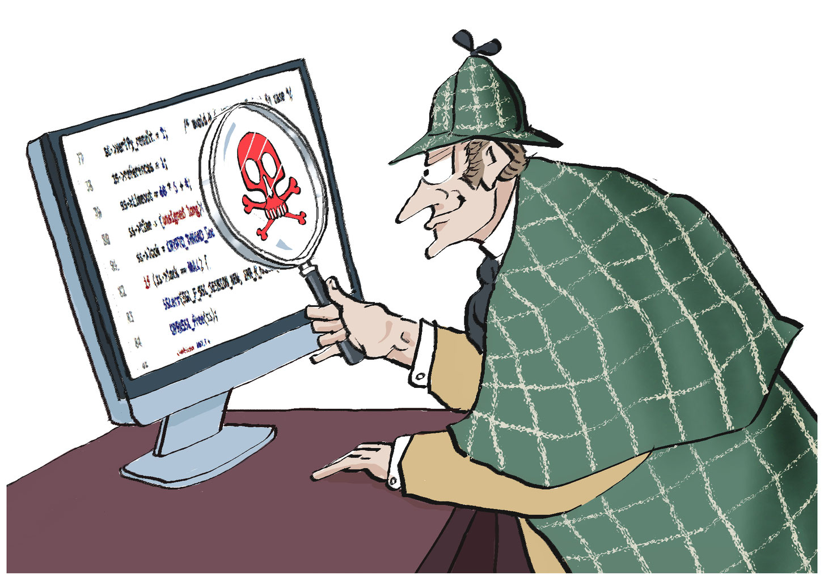
Code Review

Slide 17
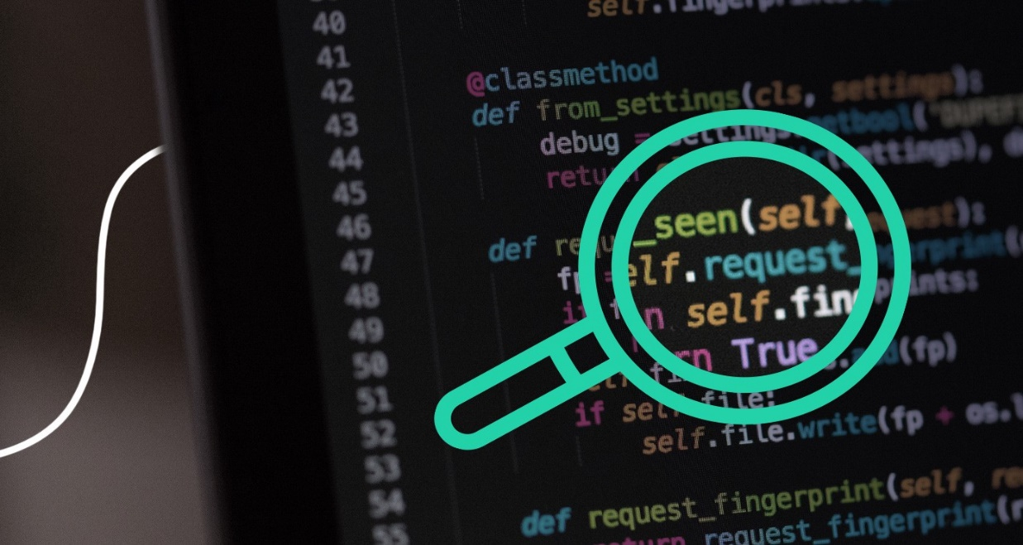
Code Review
Code review – an activity in which people other than the author of a software deliverable examine it for defects and improvement opportunities – is one of the most powerful software quality tools available.
Code reviews help novice developers to learn from the senior developers on best practices of writing code.
Code review best practices
Keep the changes small and focused
Ensure logical coherence of changes
Be positive, polite and respectful

Slide 18
Yard Sticks I used when doing my Code Review
Does the new feature add value or is it a sign of feature-creep?
Is the code properly planned and designed?
Is the code well organized in terms of placement of components?
Does the code keep with the idioms and code patterns of the language?
Does the code make use of the language features and standard libraries?
Is the code clear and concise?
Does it comply with PEP-8?
Are all language and project conventions followed?
Are identifiers given meaningful and style guide-compliant names?

Slide 19
Code Review check list
Is the code self-documenting or well-documented?
Is the code free of obfuscation and unnecessary complexity?
Is the control flow and component relationship clear to understand?
Is the code free of implementation bugs that could be exploited?
Have all the new dependencies been audited for vulnerabilities?
Is the code optimized for in terms of time and space complexity?
Does it scale as per the need?
Does it have instrumentation like reporting for metrics and alerting for failures?

Slide 20
Use Code review tool
Tools used to identify issues
1. Manual way
2. use of python tools such as pylint and flake8
When I ran flake8 on the scripts, there were a lot of errors that needed to be fixed

Slide 21
Performing Code Review
Review on github repository https://github.com/miltonpereira/Scrapper
1. README File can not be empty
2. License Information missing
3. Naming Convention Structure
4. Unused packages in the requirements.txt file
5. Confusing project structure
6. Inconsistence function and function names
7. Existence of redundant code in functions
8. Improper use of conditional statements

Slide 22
Recommendations
Use formatting tool like flake8 to help in formatting your code and identify inconsistencies that would make your code unreadable to other developers and you yourself after some time lapse.
Continue with the best practice of making the functions short but also ensure to write python code following the basic python conventions specified in PEP8 standards.
I have refactored the repository cloned with all the suggested changes and I have made git pull request, if you find it worthy, you can integrate them into your repo.

Slide 23
Code Review necessitates Refactoring
To bring to life the changes recommended after code review, code refactor is introduced

Slide 24
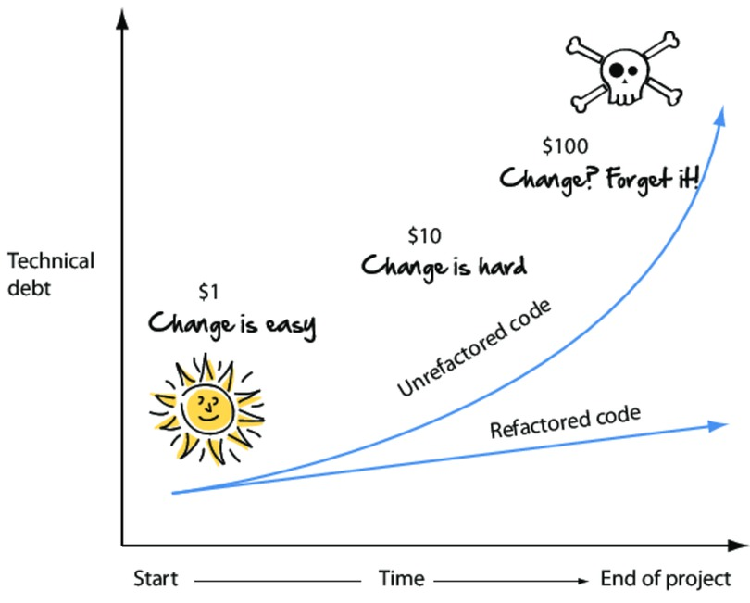
Code Refactoring

Slide 25

What is code refactoring?
Code refactoring is a process that involves restructuring a computer code base without adding new features or changes to its external behavior.
It generally consists of carrying out a series of small changes to the code base that are minor enough to avoid introducing new errors with the main intention of reducing technical debt

Slide 26
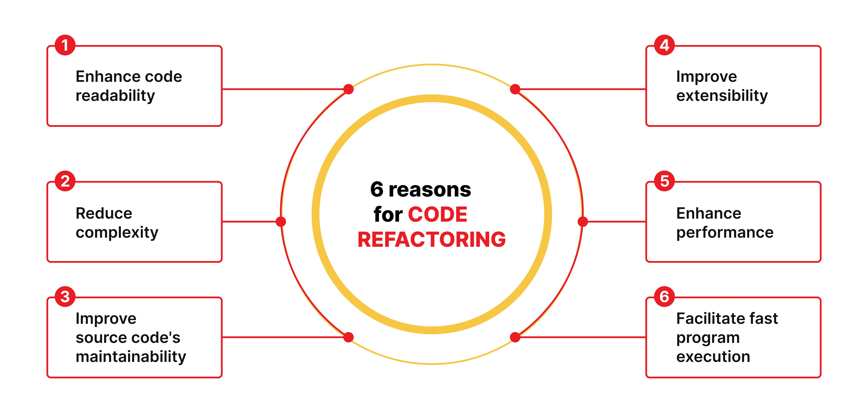
Reason for doing code refactoring

Slide 27
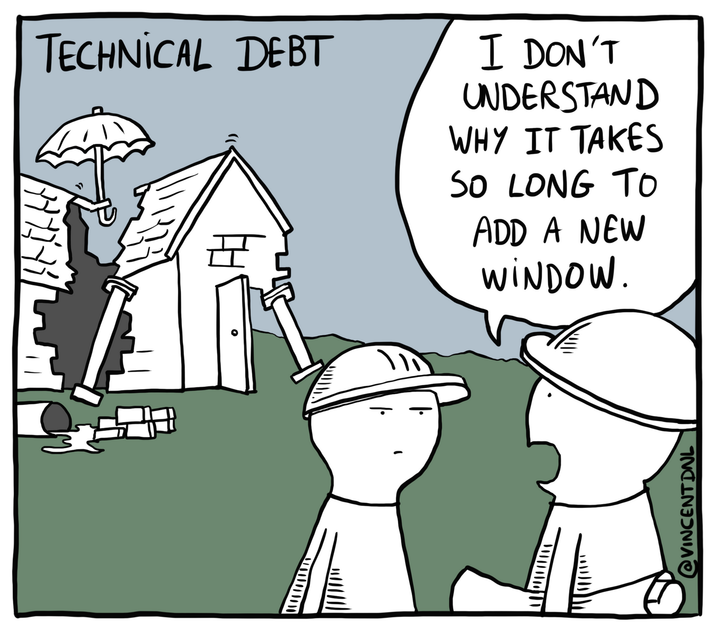
Effects of not refactoring code
Technical debt is the price a company will pay later for choosing a simpler, faster, yet less reliable option today. Any compromise you make to release products or features faster in the present will accumulate a greater volume of work to do in the future:

Slide 28
Performing Code Refactoring
I refactored the following code projects
1. Web scraper github repository
2. Py Game
3. Library Web application(Not Code refactoring)
My Main Emphasis
Make the code more readable
Create shorter classes
Follow proper coding techniques such as formatting
Restructure code in such away that adding future changes is not so hard.

